Slide 1
Dividend Policy

Slide 2
Different Types of Dividends
Many companies pay a regular cash dividend.
Public companies often pay quarterly.
Sometimes firms will throw in an extra cash dividend.
The extreme case would be a liquidating dividend.
Often companies will declare stock dividends.
No cash leaves the firm.
The firm increases the number of shares outstanding.
Some companies declare a dividend in kind.
Wrigley’s Gum sends around a box of chewing gum.
Dundee Crematoria offers shareholders discounted cremations.

Slide 3
Important dates in Cash Dividend Payment
Cash Dividend - Payment of cash by the firm to its shareholders.
Ex-Dividend Date - Date that determines whether a stockholder is entitled to a dividend payment; anyone holding stock before this date is entitled to a dividend.
Record Date - Person who owns stock on this date received the dividend.
Notes:
5

Slide 4
Procedure for Cash Dividend Payment
25 Oct.
1 Nov.
2 Nov.
6 Nov.
7 Dec.
…
Declaration Date
Cum-dividend Date
Ex-dividend Date
Record Date
Payment Date
Declaration Date: The Board of Directors declares a payment of dividends.
Cum-Dividend Date: The last day that the buyer of a stock is entitled to the dividend.
Ex-Dividend Date: The first day that the seller of a stock is entitled to the dividend.
Record Date: The corporation prepares a list of all individuals believed to be stockholders as of 6 November.

Slide 5
Price Behavior around the Ex-Dividend Date
In a perfect world, the stock price will fall by the amount of the dividend on the ex-dividend date.
-t … -2 -1 0 +1 +2 …
$P
$P - div
The price drops by the amount of the cash dividend
Ex-dividend Date
Taxes complicate things a bit. Empirically, the price drop is less than the dividend and occurs within the first few minutes of the ex-date.

Slide 6
Dividend Stripping
There was nothing in the Reliance Quant Plus Fund to attract an investor. The fund has consistently lagged its category and the benchmark Nifty in the past five years. Its past one year performance was ranked 141 out of 143 large-cap equity funds.
Yet, the scheme attracted an estimated Rs 1,800 crore during June 2015. The trigger: the Rs 4.20 dividend announced by the fund.
(Economic Times 3 August 2015)

Slide 7
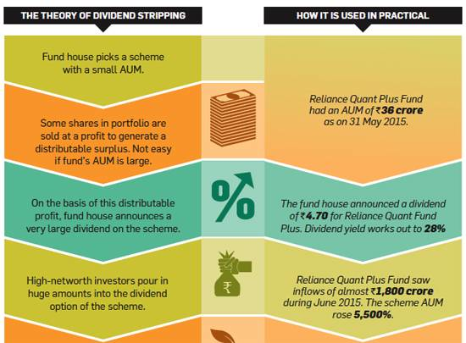

Slide 8
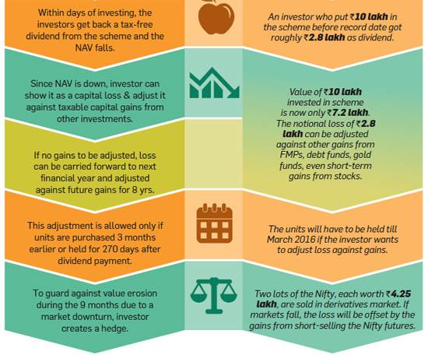

Slide 9
MFs under SEBI lens for dividend stripping (ET, Jan 13, 2016)
The government might change the current guidelines to do away with the practice of dividend stripping in the upcoming Budget.
The email by Sebi cites a newspaper article written in November last year which stated that between April 2014 and October 2015 about Rs 25,000 crore was collected in dividend stripping schemes, creating an accounting book loss of more than Rs 8,000 crore.

Slide 10
Change in tax laws
Section 94(7)
As per sec. 94(7),Where—
(a) any person buys or acquires any securities or unit within a period of three months prior to the record date;
(b) such person sells or transfers—
(i) such securities within a period of three months after such date; or
(ii) such unit within a period of nine months after such date;
(c) the dividend or income on such securities or unit received or receivable by such person is exempt,
then, the loss, if any, arising to him on account of such purchase and sale of securities or unit, to the extent such loss does not exceed the amount of dividend or income received or receivable on such securities or unit, shall be ignored for the purposes of computing his income chargeable to tax.

Slide 11
What is dividend policy?
It’s the decision to pay out earnings versus retaining and reinvesting them. Includes these elements:
1. High or low payout?
2. Stable or irregular dividends?
3. How frequent?
4. Do we announce the policy?

Slide 12
Do investors prefer high or low payouts? There are three theories:
Dividends are irrelevant: Investors don’t care about payout.
Bird-in-the-hand: Investors prefer a high payout.
Tax preference: Investors prefer a low payout, hence growth.

Slide 13
Dividend Irrelevance Theory
Investors are indifferent between dividends and retention-generated capital gains. If they want cash, they can sell stock. If they don’t want cash, they can use dividends to buy stock.
Modigliani-Miller support irrelevance.
Theory is based on unrealistic assumptions (no taxes or brokerage costs), hence may not be true. Need empirical test.

Slide 14
Homemade Dividends
Bianchi Inc. is a $42 stock about to pay a $2 cash dividend.
Bob Investor owns 80 shares and prefers $3 cash dividend.
Bob’s homemade dividend strategy:
Sell 2 shares ex-dividend
homemade dividends
Cash from dividend $160
Cash from selling stock $80
Total Cash $240
Value of Stock Holdings $40 × 78 =
$3,120
$3 Dividend
$240
$0
$240
$39 × 80 =
$3,120

Slide 15
Dividend Policy is Irrelevant
Since investors do not need dividends to convert shares to cash, dividend policy will have no impact on the value of the firm.
In the above example, Bob Investor began with total wealth of $3,360:
$
42
$
3
,
360
=
80
shares
×
share
After a $3 dividend, his total wealth is still $3,360:
$
39
$
3
,
360
=
80
shares
×
+
$
240
share
After a $2 dividend, and sale of 2 ex-dividend shares,his total wealth is still $3,360:
$
40
$
3
,
360
=
78
shares
×
+
$
160
+
$
80
share
Notes:
19

Slide 16
Irrelevance of Stock Dividends: Example
Shimano USA has 2 million shares currently outstanding at $15 per share. The company declares a 50% stock dividend. How many shares will be outstanding after the dividend is paid?
A 50% stock dividend will increase the number of shares by 50%:
2 million×1.5 = 3 million shares
After the stock dividend what is the new price per share and what is the new value of the firm?
The value of the firm was $2m × $15 per share = $30 m. After the dividend, the value will remain the same.
Price per share = $30m/ 3m shares = $10 per share
Notes:
12

Slide 17
Dividends and Investment Policy
Firms should never forgo positive NPV projects to increase a dividend (or to pay a dividend for the first time).
Recall that on of the assumptions underlying the dividend-irrelevance arguments was “The investment policy of the firm is set ahead of time and is not altered by changes in dividend policy.”

Slide 18
Repurchase of Stock
Instead of declaring cash dividends, firms can rid itself of excess cash through buying shares of their own stock.
Share repurchase has become an important way of distributing earnings to shareholders.

Slide 19
Stock Repurchase versus Dividend
Consider a firm that wishes to distribute $100,000 to its shareholders.
Assets
Liabilities
&
Equity
A.
Original
balance
sheet
Cash
$150,000
Debt
0
Other
assets
850,000
Equity
1,000,000
Value of Firm
1,000,000
Value of Firm
1,000,000
Shares
outstanding
=
100,000
Price per share
=
$1,000,000
/100,000
=
$10
Notes:
15

Slide 20
Stock Repurchase versus Dividend
If they distribute the $100,000 as cash dividend, the balance sheet will look like this:
Assets
Liabilities
s
&
Equity
B.
After
$1
per
share
cash
dividend
Cash
$50,000
Debt
0
Other
assets
850,000
Equity
900,000
Value
of
Firm
900,000
Value
of
Firm
900,000
Shares
outstanding
g
=
100,000
Price
per
share
=
$900,000/1
00,000
=
$9
Notes:
16

Slide 21
Stock Repurchase versus Dividend
If they distribute the $100,000 through a stock repurchase, the balance sheet will look like this:
Assets
Li
abilities
&
Equity
C.
After stock repurchase
Cash
$50,000
Debt
0
Other assets
850,000
Equity
900,000
Value of Firm
900,000
Value of Firm
900,000
Shares outstanding
=
90,000
Price per
share
=
$900,000
/
90,000
=
$10
Notes:
17

Slide 22
Bird-in-the-Hand Theory
Investors think dividends are less risky than potential future capital gains, hence they like dividends.
If so, investors would value high payout firms more highly, i.e., a high payout would result in a high P₀.

Slide 23
Tax Preference Theory
Retained earnings lead to capital gains, which are taxed at lower rates than dividends. Capital gains taxes are also deferred.
This could cause investors to prefer firms with low payouts, i.e., a high payout results in a low P₀.

Slide 24
Implications of 3 Theories for Managers
Theory
Implication
Irrelevance
Any payout OK
Bird-in-the-hand
Set high payout
Tax preference
Set low payout
But which, if any, is correct???

Slide 25
Which theory is most correct?
Empirical testing has not been able to determine which theory, if any, is correct.
Thus, managers use judgment when setting policy.
Analysis is used, but it must be applied with judgment.

Slide 26
Lintner’s theory on dividend policy
Lintner found that:
firms have long-run target pay out ratios;
firms focus on year-to-year dividend changes rather than absolutes;
Dividend changes follow changes in long-run sustainable earnings;
Firms avoid dividend policy changes that might need to be reversed in future.

Slide 27
Factors affecting Dividend Policy
Signalling. DON’T CUT
Taxes and clienteles. MIXED
Transactions Costs. CUT
Agency Conflicts CUT
Behavioural Finance

Slide 28
What’s the “information content,” or “signaling,” hypothesis?
Managers hate to cut dividends, so won’t raise dividends unless they think raise is sustainable. So, investors view dividend increases as signals of management’s view of the future.
Therefore, a stock price increase at time of a dividend increase could reflect higher expectations for future EPS, not a desire for dividends.

Slide 29
What’s the “clientele effect”?
Different groups of investors, or clienteles, prefer different dividend policies.
Firm’s past dividend policy determines its current clientele of investors.
Clientele effects impede changing dividend policy. Taxes & brokerage costs hurt investors who have to switch companies.

Slide 30
What’s the “residual dividend model”?
Find the retained earnings needed for the capital budget.
Pay out any leftover earnings (the residual) as dividends.
This policy minimizes flotation and equity signaling costs, hence minimizes the WACC.

Slide 31
Using the Residual Model to Calculate Dividends Paid
[
(
)
(
]
)
Target
equity
ratio
Total
capital
budget
Net
income
Dividends = – .

Slide 32
Catering Theory of Dividend (Baker and Wurgler)
The decision to pay dividends is driven by investor demand.
Managers cater to investors by paying dividends when investors put a stock price premium on payers and not paying when investors prefer nonpayers.
Nonpayers initiate dividends when demand for payers is high.
Dividend premium is the difference between the average market-to-book ratio of dividend payers and nonpayers.

Slide 33
Example (18.19)
G Co. has a current cash flow of $1.2 million and pays no dividend. The PV of the company’s future cash flows is $15 million. The all-equity company has 1 million outstanding shares. No dividend tax.
What is the current share price of G Co.?
Suppose G Co. announces its plan to pay 50% of current cash flows as dividend. How can Jeff, who owns 1000 shares of G Co., achieve a zero pay out policy on his own?

Slide 34
Example (18.17)
FC is evaluating an extra dividend versus a share repurchase. In either case $5000 would be spent. Current earnings are $0.95 per share, and the stock currently sells at $40. There are 200 shares outstanding. Ignore tax
Evaluate the two alternatives in terms of the effect on the price per share of the stock and shareholder wealth.
What will be the effect on FC’s EPS and PE ratio under the two different scenarios?

